Slide 1

Distributed Objects Programming
- Remote Invocation
Rajkumar Buyya
Cloud Computing and Distributed Systems (CLOUDS) Laboratory
School of Computing and Information Systems
The University of Melbourne, Australia
http://www.cloudbus.org/652
Co-contributors: Xingchen Chu, Rodrigo Calheiros, Maria Sossa, Shashikant Ilager
Some concepts are
drawn from Chapter 5
Sun Java online tutorials:
http://java.sun.com/docs/books/tutorial/rmi/

Slide 2
Outline
Introduction to Distributed Objects
Remote Method Invocation (RMI) Architecture
RMI Programming and a Sample Example:
  Server-Side RMI programming
  Client-Side RMI programming
Advanced RMI Concepts
  Security Policies
  Exceptions
  Dynamic Loading
A more advanced RMI application
  Math Server
RPC and Summary
Notes:
What are the steps involved in server-side and client-side RMI?
What advanced concepts can we use to make our program production ready? Security policies to restrict access and encrypt data flow?
What exceptions will we come across? Can we dynamically deploy our service?

Slide 3

Introduction
We cover high-level programming models for distributed systems. Two widely used models are:
  Remote Procedure Call (RPC) - an extension of the conventional procedure call model
  Remote Method Invocation (RMI) - an extension of the object-oriented programming model.
Applications
Remote invocation, indirect communication
Underlying interprocess communication primitives:
layers
Sockets, message passing, multicast support, overlay networks
TCP and UDP

Slide 4
Request-Reply Protocol
Exchange protocol for the implementation of remote invocation in a distributed system.
We discuss the protocol based on three abstract operations: doOperation, getRequest and sendReply
Client
Server
doOperation
Request
message
getRequest
select object
(wait)
execute
Reply
method
message
sendReply
(continuation)

Slide 5
Request-Reply Operations
public byte[] doOperation (RemoteRef s, int operationId, byte[] arguments)
  Sends a request message to the remote server and returns the reply
  The arguments specify the remote server, the operation to be invoked and the arguments of that operation
public byte[] getRequest ()
  Acquires a client request via the server port
public void sendReply (byte[] reply, InetAddress clientHost, int clientPort)
  Sends the reply message reply to the client at its Internet address and port

Slide 6
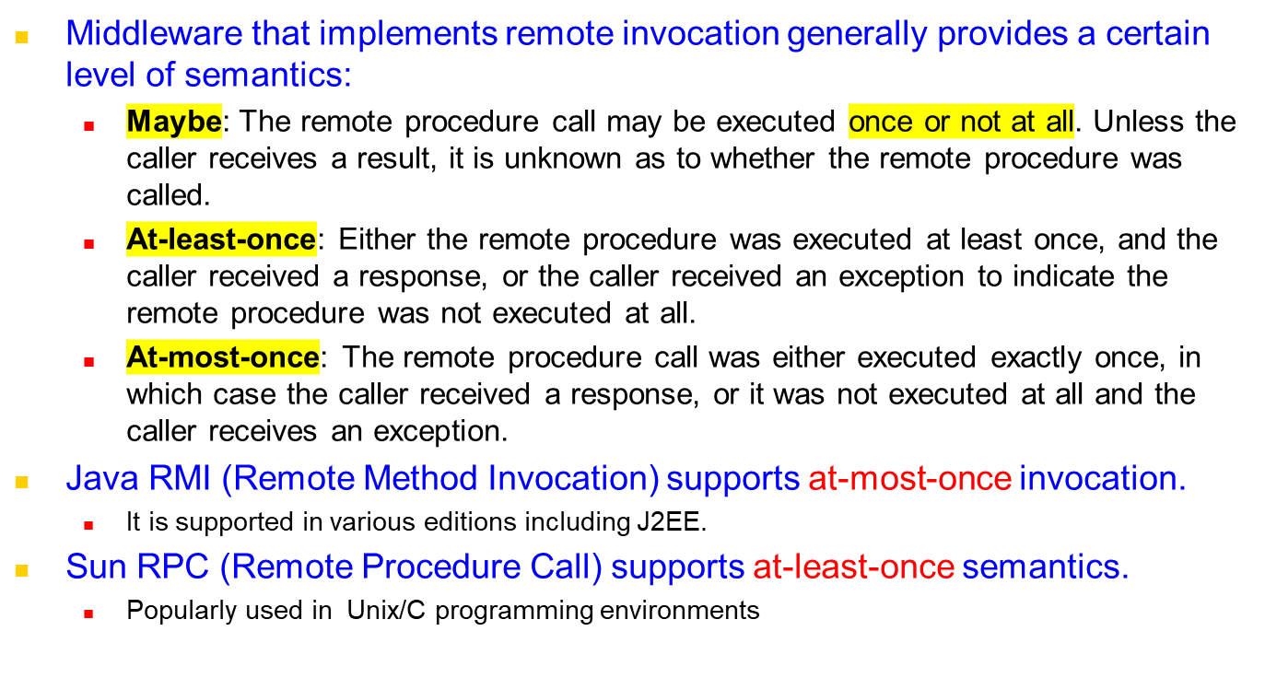
Invocation Semantics

Slide 7
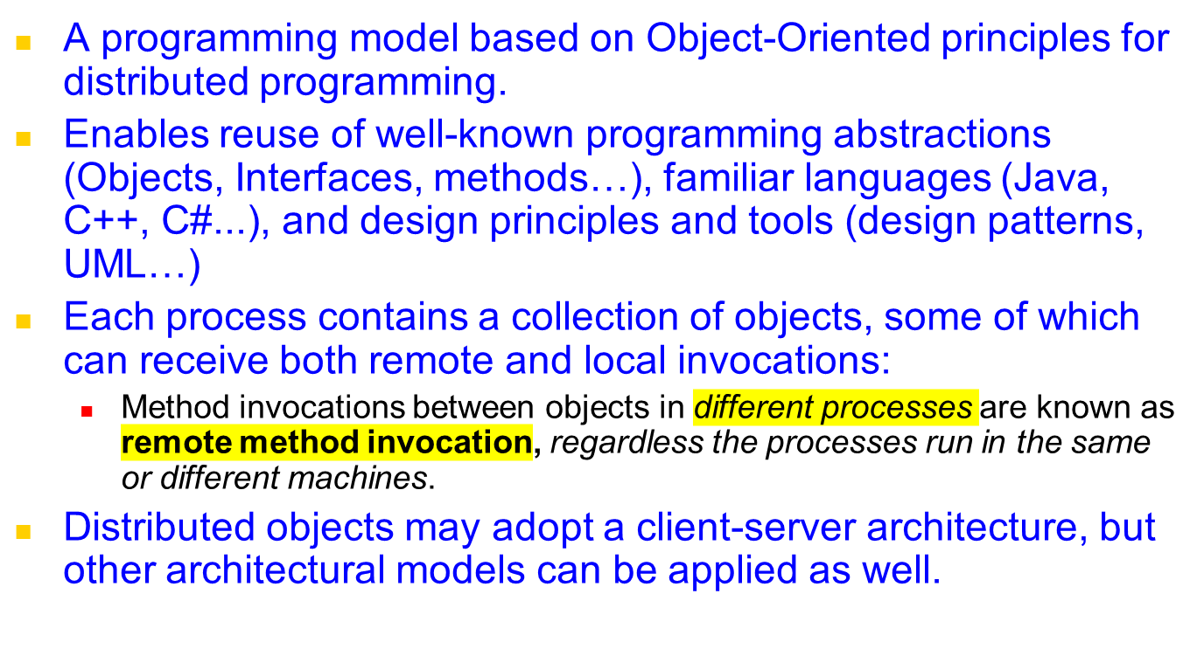
Distributed Objects
Notes:
Available reliably from java “2” aka Java 1.2
Has been consistently improved since then for each new Java version.
Data must be Serializable (or Remote) so that RMI can marshall (flatten) and unmarshall (reconstruct) the data
Primatives (int/float/etc) are inherently serializable, as are many Objects

Slide 8
Outline
Introduction to Distributed Objects
Remote Method Invocation (RMI) Architecture
RMI Programming and a Sample Example:
  Server-Side RMI programming
  Client-Side RMI programming
Advanced RMI Concepts
  Security Policies
  Exceptions
  Dynamic Loading
A more advanced RMI application
  Math Server
RPC and Summary
Notes:
What are the steps involved in server-side and client-side RMI?
What advanced concepts can we use to make our program production ready? Security policies to restrict access and encrypt data flow?
What exceptions will we come across? Can we dynamically deploy our service?

Slide 9
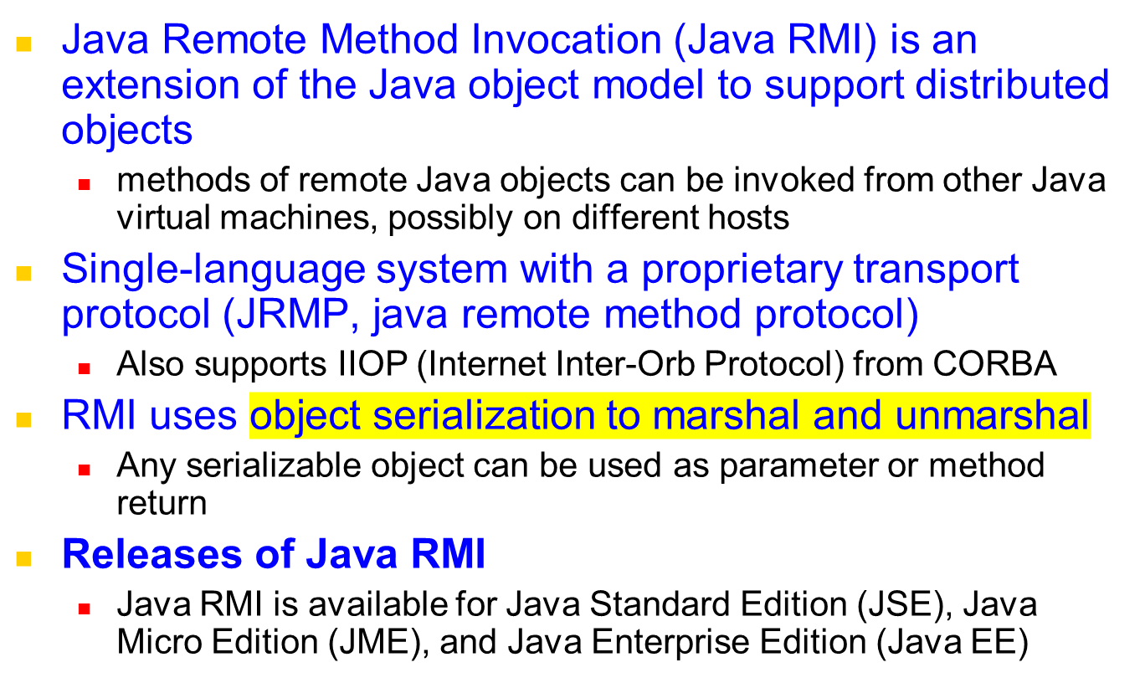
Java RMI
Notes:
Available reliably from java “2” aka Java 1.2
Has been consistently improved since then for each new Java version.
Data must be Serializable (or Remote) so that RMI can marshall (flatten) and unmarshall (reconstruct) the data
Primatives (int/float/etc) are inherently serializable, as are many Objects

Slide 10
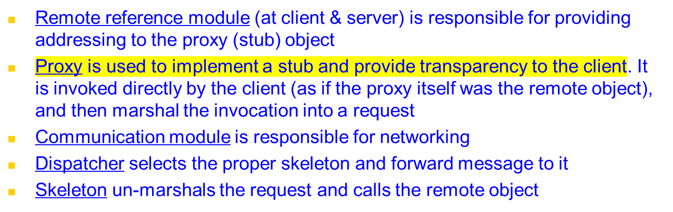
RMI Architecture and Components
client
server
remote
object A
proxy for B
skeleton
object B
Request
& dispatcher
for B’s class
Reply
servant
Remote
Communication
Communication
Remote reference
reference module
module
module
module
Notes:
Remote reference modules exist at client/server, and is the middleware between the stub and skeleton and the transport protocols, handling creation and management of remote references
Proxy/skel are the interfaces client/server uses to interact
Dispatcher matches the request to the appropriate skeleton (there could be many)

Slide 11
Invocation Lifecycle
Client
Server
Client Code
RMI Object
Invoke method via stub
Returns response
Calls actual method with args
Returns response / exception
1
8
4
5
Stub
Skeleton
Serializes arguments, transmit
Receives, deserialises response
Receives, deserialises arguments
Serialises response, transmit
2
7
3
6
Network

Slide 12
Outline
Introduction to Distributed Objects
Remote Method Invocation (RMI) Architecture
RMI Programming and a Sample Example:
  Server-Side RMI programming
  Client-Side RMI programming
Advanced RMI Concepts
  Security Policies
  Exceptions
  Dynamic Loading
A more advanced RMI application
  Math Server
RPC and Summary
Notes:
What are the steps involved in server-side and client-side RMI?
What advanced concepts can we use to make our program production ready? Security policies to restrict access and encrypt data flow?
What exceptions will we come across? Can we dynamically deploy our service?

Slide 13
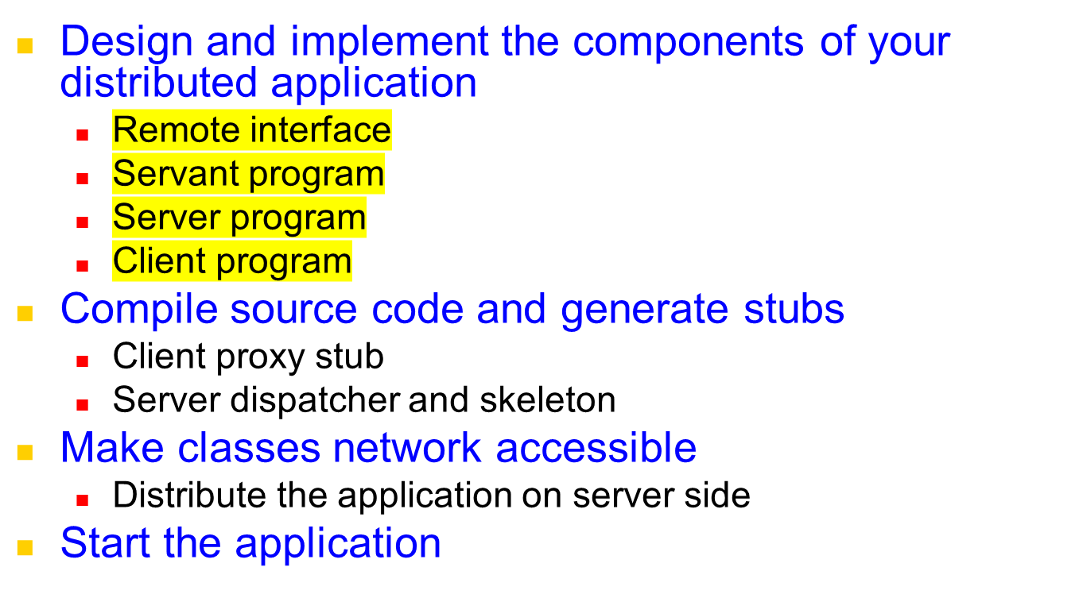
Steps for implementing an RMI application
Notes:
Many steps to creating a remote service
-Inteface defines a set of methods we wish to make available (based on user requirements and agreement)
-Servant implements the methods defined in Interface
-Server program is the “driver”, usually registers with naming service
REPEAT IF NECCESSARY

Slide 14
RMI Programming and Examples
  Application Design
    Remote Interface
      Exposes the set of methods and properties available
      Defines the contract between the client and the server
      Constitutes the root for both stub and skeleton
    Servant component
      Represents the remote object (skeleton)
      Implements the remote interface
    Server component
      Main driver that makes available the servant
      It usually registers with the naming service
    Client component

Slide 15
Java RMI
Client
Server
RemotObj proxy <implements RemoteInterface>
6. method1()
<Request over the network>
RemoteObj Dispatcher/
Skeleton
7. method1()
9. Return value
<Reply over the network>
RemoteObj
<implements RemoteInterface>
5. method1()
10. Return
value
8. return value
Client
Server
1. new RemoteObj()
4. Return RemoteObj proxy
RMI Registry
2. bind(“myRO”, RemoteObj)
3. lookup(“myRO”)
<“myRO”, Remote Ref. to RemoteObj>

Slide 16
Example application – Hello World
Server side
  Create a HelloWorld interface
  Implement HelloWorld interface with methods
  Create a main method to register the HelloWorld service in the RMI Name Registry
  Generate Stubs and Start RMI registry
  Start Server
Client side
  Write a simple Client with main to lookup HelloWorld Service and invoke the methods

Slide 17
1. Define Interface of remote method
//file: HelloWorld.java
import java.rmi.Remote;
import java.rmi.RemoteException;
public interface HelloWorld extends Remote {
public String sayHello(String who) throws RemoteException;
}

Slide 18
2. Define RMI Server Program
// file: HelloWorldServer.java
import java.rmi.Naming;
import java.rmi.Remote;
import java.rmi.RemoteException;
import java.rmi.server.UnicastRemoteObject;
public class HelloWorldServer extends UnicastRemoteObject implements HelloWorld {
public HelloWorldServer() throws RemoteException {
super();
}
public String sayHello(String who) throws RemoteException {
return "Hello "+who+" from your friend RMI 433-652 :-)";
}
public static void main(String[] args) {
String hostName = "localhost";
String serviceName = "HelloWorldService";
if(args.length == 2){
hostName = args[0];
serviceName = args[1];
}
try{
HelloWorld hello = new HelloWorldServer();
Naming.rebind("rmi://"+hostName+"/"+serviceName, hello);
System.out.println("HelloWorld RMI Server is running...");
}catch(Exception e){
e.printStackTrace();
}
}
}

Slide 19
3. Define Client Program
// file: RMIClient.java
import java.rmi.Naming;
public class RMIClient {
public static void main(String[] args) {
String hostName = "localhost";
String serviceName = "HelloWorldService";
String who = "Raj";
if(args.length == 3){
hostName = args[0];
serviceName = args[1];
who = args[2];
}
else if(args.length == 1){
who = args[0];
}
try{
HelloWorld hello = (HelloWorld)Naming.lookup("rmi://"+hostName+"/"+serviceName);
System.out.println(hello.sayHello(who));
}catch(Exception e){
e.printStackTrace();
}
}
}

Slide 20
Define Access Policy
Example: File HelloPolicy to contain
grant { permission java.security.AllPermission "", ""; };

Slide 21
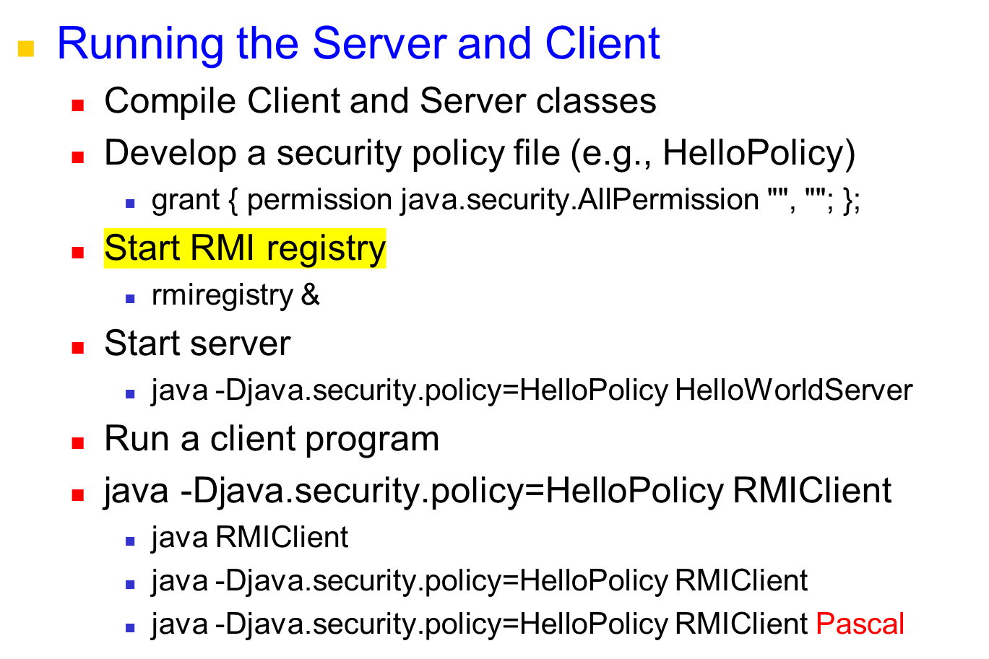
Java RMI Example

Slide 22
Outline
Introduction to Distributed Objects
Remote Method Invocation (RMI) Architecture
RMI Programming and a Sample Example:
  Server-Side RMI programming
  Client-Side RMI programming
Advanced RMI Concepts
  Security Policies
  Exceptions
  Dynamic Loading
A more advanced RMI application
  Math Server
RPC and Summary
Notes:
What are the steps involved in server-side and client-side RMI?
What advanced concepts can we use to make our program production ready? Security policies to restrict access and encrypt data flow?
What exceptions will we come across? Can we dynamically deploy our service?

Slide 23
Security Manager
Java’s security framework
  java.security.-
  Permissions, Principle, Domain etc.
  Security manager, for access control (file, socket, class load, remote code etc)
  $JAVA_HOME/jre/lib/security/java.policy
Use security manager in RMI
  RMI recommends to install a security manager, or RMI may not work properly while encountering security constraints.
  A security manager ensures that the operations performed by downloaded code go through a set of security checks.
    Eg. Connect and accept ports for RMI socket and allowing code downloading
Notes:
Why use a security manager? We don’t want rogue java applications or applets downloading arbitrary remote code and executing it!
Security manager is usually required at both the client and server

Slide 24
Security Manager (cont.)
Two ways to declare security manager
  Use System property java.security.manager
    java –Djava.security.manager HelloWorldImpl
  Explicit declare in the source code
    public static void main(String[]args){
    //check current security manager
    if(System.getSecurityManager()==null){
    System.setSecurityManager(new SecurityManager ());
    }
    …
    //lookup remote object and invoke methods.
    }
Use customized policy file instead of java.policy
  Usage
    java -Djava.security.manager -Djava.security.policy=local.policy HelloWorldImpl
Notes:
We can use a system wide, default security manager by using the command line argument.
Alternatively, we can define and set our own SecurityManager to control access to our server
Client can use default system wide policy (usually restrictive, e.g. to stop applets from misuse) or define more permissive local.policy

Slide 25
File: “local.policy” contents
Specific permissions:
grant {
permission java.net.SocketPermission "*:1024-65535","connect,accept";
permission java.io.FilePermission "/home/globus/RMITutorial/-", "read";
};
Grant all permissions:
grant {
permission java.security.AllPermission;
};
Notes:
We can have per user policies, where a user can define there own local.policy and place it in their home drive.
This can allow more permissive access than the default
E.g. I may want to allow access to certain ports or certain files, or everything (useful for debugging)

Slide 26
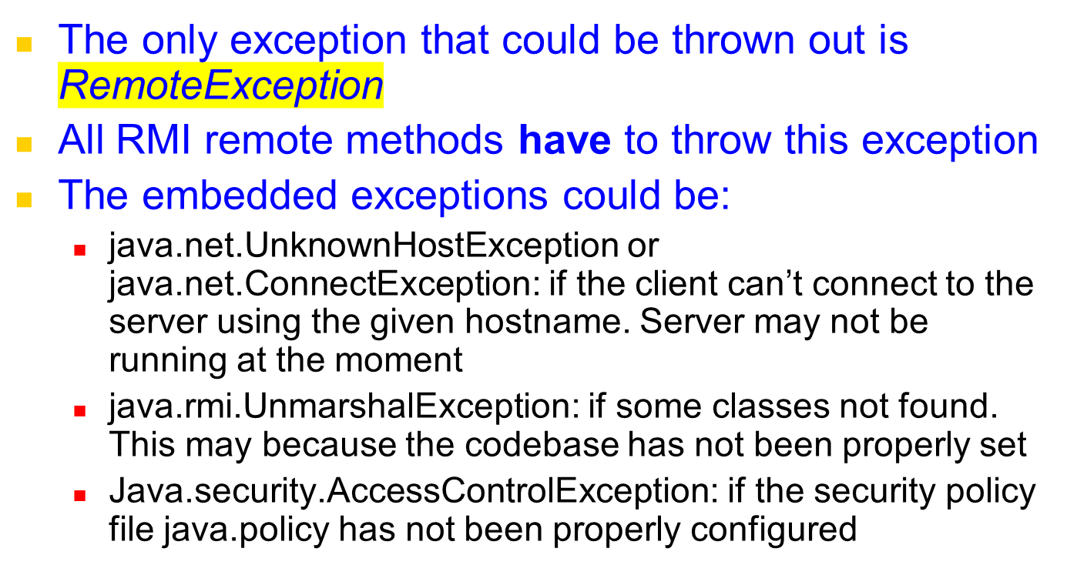
Exceptions
Notes:
UnmarshalException is probably the most common exception for beginner RMI programmers. Can occur on the server if CLASSPATH is set incorrectly for the Server or the rmiregistry
Can happen on client if stubs are missing and the codebase has not been set to allow automatic download of the stubs from the server
AccessControlException can occur if the java.policy is not permissive enough for the client run execute correctly

Slide 27
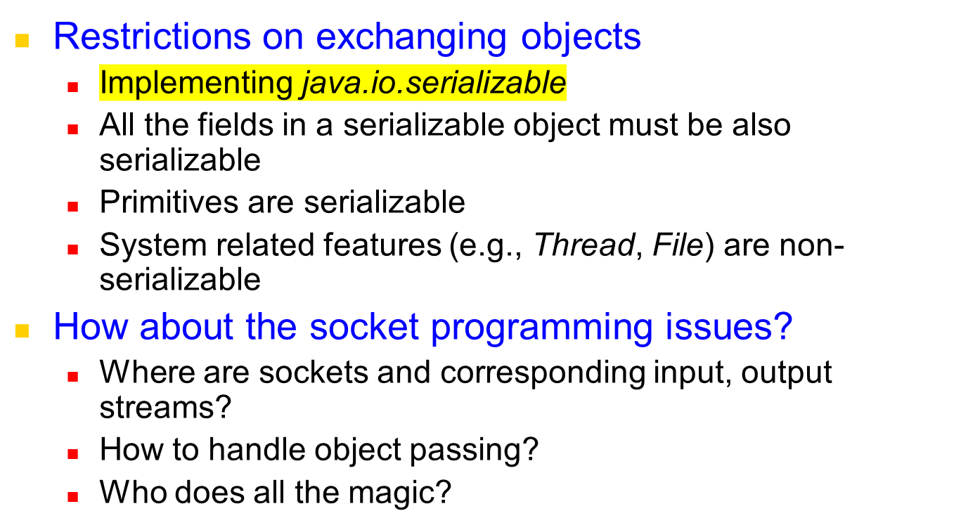
Passing objects
Notes:
Mentioned earlier that objects returned over RMI either need to be Remote (for the remote reference) or Serializable
For an object to be Serializable all member fields must also be Serializable
Many system features such as Thread and File are non-serializable. So we couldn’t return a file reference over RMI, but we could return an actual file as a
byte[] array
Much of the complexity is hidden from us, thankfully!

Slide 28
RMI Dynamic Class Loading
Ability to download bytecode (classes) from Remote JVM
New types can be introduced into a remote virtual machine without informing the client
  Extend the behavior of an application dynamically
  Removes the need to deploy stubs manually
Explicit set property to support dynamic class load
  Specify system property java.rmi.server.codebase to tell the program where to download classes
Notes:
Allows client to receive latest stub definitions without manually placing stub on client
New or modified interfaces or types can be introduced as needed
Dynamic loading can be achieved by setting the
-Djava.rmi.server.codebase=http://www.server.com/classes
Or file:///var/classes

Slide 29
Outline
Introduction to Distributed Objects
Remote Method Invocation (RMI) Architecture
RMI Programming and a Sample Example:
  Server-Side RMI programming
  Client-Side RMI programming
Advanced RMI Concepts
  Security Policies
  Exceptions
  Dynamic Loading
A more advanced RMI application
  Math Server
RPC and Summary
Notes:
What are the steps involved in server-side and client-side RMI?
What advanced concepts can we use to make our program production ready? Security policies to restrict access and encrypt data flow?
What exceptions will we come across? Can we dynamically deploy our service?

Slide 30
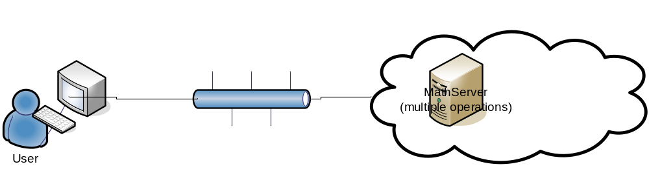

A Simple Math Server in RMI
Math Service

Slide 31
Java RMI Example
Specify the Remote Interface
public interface IRemoteMath extends Remote {
double add(double i, double j) throws RemoteException;
double subtract(double i, double j) throws RemoteException;
}

Slide 32
Java RMI Example
Implement the Servant Class
public class RemoteMathServant extends UnicastRemoteObject implements IRemoteMath {
public double add ( double i, double j ) throws RemoteException {
return (i+j);
}
public double subtract ( double i, double j ) throws RemoteException {
return (i-j);
}
}

Slide 33
Java RMI Example
Implement the server
public class MathServer {
public static void main(String args[]){
System.setSecurityManager(new RMISecurityManager());
try{
IRemoteMath remoteMath = new RemoteMathServant();
Registry registry = LocateRegistry.getRegistry();
registry.bind("Compute", remoteMath );
System.out.println("Math server ready");
}catch(Exception e) {
e.printStackTrace();
}
}
}

Slide 34
Java RMI Example
Implement the client program
public class MathClient {
public static void main(String[] args) {
try {
if(System.getSecurityManager() == null)
System.setSecurityManager( new RMISecurityManager() );
LocateRegistry.getRegistry("localhost");
IRemoteMath remoteMath = (IRemoteMath) registry.lookup("Compute");
System.out.println( "1.7 + 2.8 = ” + remoteMath.add(1.7, 2.8) );
System.out.println( "6.7 - 2.3 = ” + remoteMath.subtract(6.7, 2.3) );
}
catch( Exception e ) {
System.out.println( e );
}
}
}

Slide 35
Java RMI Example
Running the Server and Client
  Compile Client and Server classes
  Develop a security policy file
    grant { permission java.security.AllPermission "", ""; };
  Start RMI registry
    rmiregistry &
  Start server
    java -Djava.security.policy=policyfile MathServer
  Start client
    java -Djava.security.policy=policyfile MathClient

Slide 36
Outline
Introduction to Distributed Objects
Remote Method Invocation (RMI) Architecture
RMI Programming and a Sample Example:
  Server-Side RMI programming
  Client-Side RMI programming
Advanced RMI Concepts
  Security Policies
  Exceptions
  Dynamic Loading
A more advanced RMI application
  Math Server
RPC and Summary
Notes:
What are the steps involved in server-side and client-side RMI?
What advanced concepts can we use to make our program production ready? Security policies to restrict access and encrypt data flow?
What exceptions will we come across? Can we dynamically deploy our service?

Slide 37
Remote Procedure Call (RPC) – used in C
RPCs enable clients to execute procedures in server processes based on a defined service interface.
client process
server process
Request
Reply
client stub
server stub
procedure
procedure
client
service
program
Communication
Communication
procedure
module
module
dispatcher

Slide 38
Remote Procedure Call (RPC)
Communication Module
  Implements the desired design choices in terms of retransmission of requests, dealing with duplicates and retransmission of results
Client Stub Procedure
  Behaves like a local procedure to the client. Marshals the procedure identifiers and arguments which is handed to the communication module
  Unmarshalls the results in the reply
Dispatcher
  Selects the server stub based on the procedure identifier and forwards the request to the server stub
Server stub procedure
  Unmarshalls the arguments in the request message and forwards it to the service procedure
  Marshalls the arguments in the result message and returns it to the client

Slide 39
Summary: RMI Programming
RMI greatly simplifies creation of distributed applications (e.g., compare RMI code with socket-based apps)
Server Side
  Define interface that extend java.rmi.Remote
  Servant class both implements the interface and extends java.rmi.server.UnicastRemoteObject
  Register the remote object into RMI registry
  Ensure both rmiregistry and the server is running
Client Side
  No restriction on client implementation, both thin and rich client can be used. (Console, Swing, or Web client such as servlet and JSP)
Notes:
Hugely simplified over sockets for complex interactions. Imagine doing the file browser with sockets. We would have to define a shared protocol between client and server, parse the messages over the network to try and figure out what the client wants us to do

